Slide 1
ATM
SIMULATION
SOFTWARE

Slide 2
Main Functions Of An ATM:
Cash Withdrawal
ATM FUNCTIONS
Balance Enquiry
Cash Deposit

Slide 3
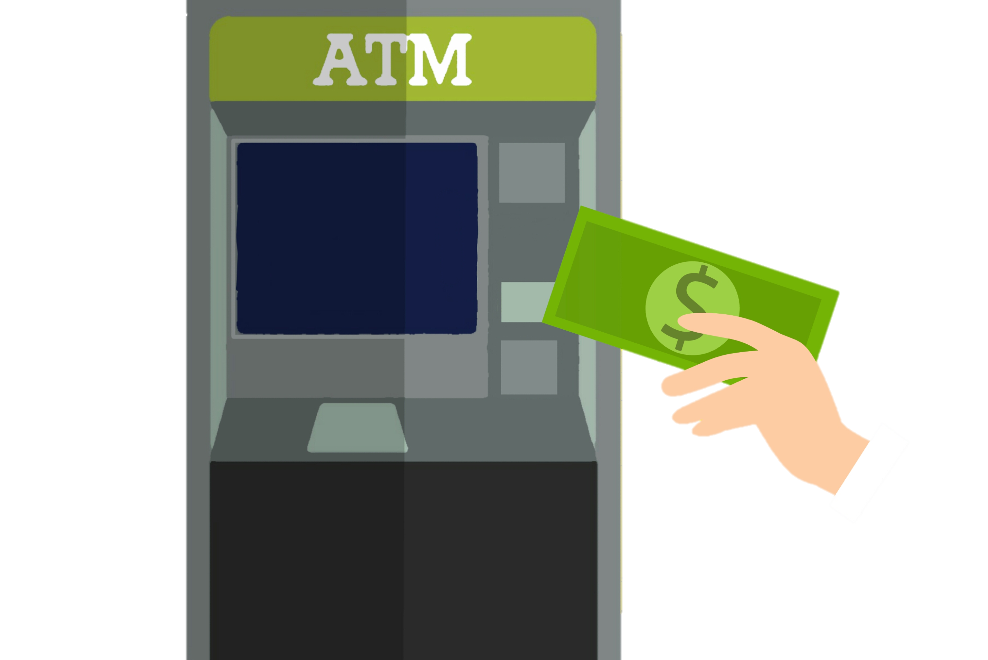
Problems Faced By New User :
Unfamiliarity with Interface
No Basic Idea of the Working of the ATM System
Possibility of Loss of Money in Case of a Mistake
Possibility of Theft or Data Leak if sought help from a
third party
Problem Statement :
The need for a Simulation Software to make the user more
accustomed to the ATM System and reduce the possibility of
error in real-time usage.

Slide 4
Solutions To Problems Faced:
Designing of user interface that provides the user an idea of
basic interface of an ATM System.
To make the user well-accustomed to the functions of an ATM
on a dummy simulation platform.
IMPLEMENTATION :
Creating a demo application to mimic the real ATM User Interface.
Making the application simple and easy to use, such that user better
understands the underlying logic.

Slide 5
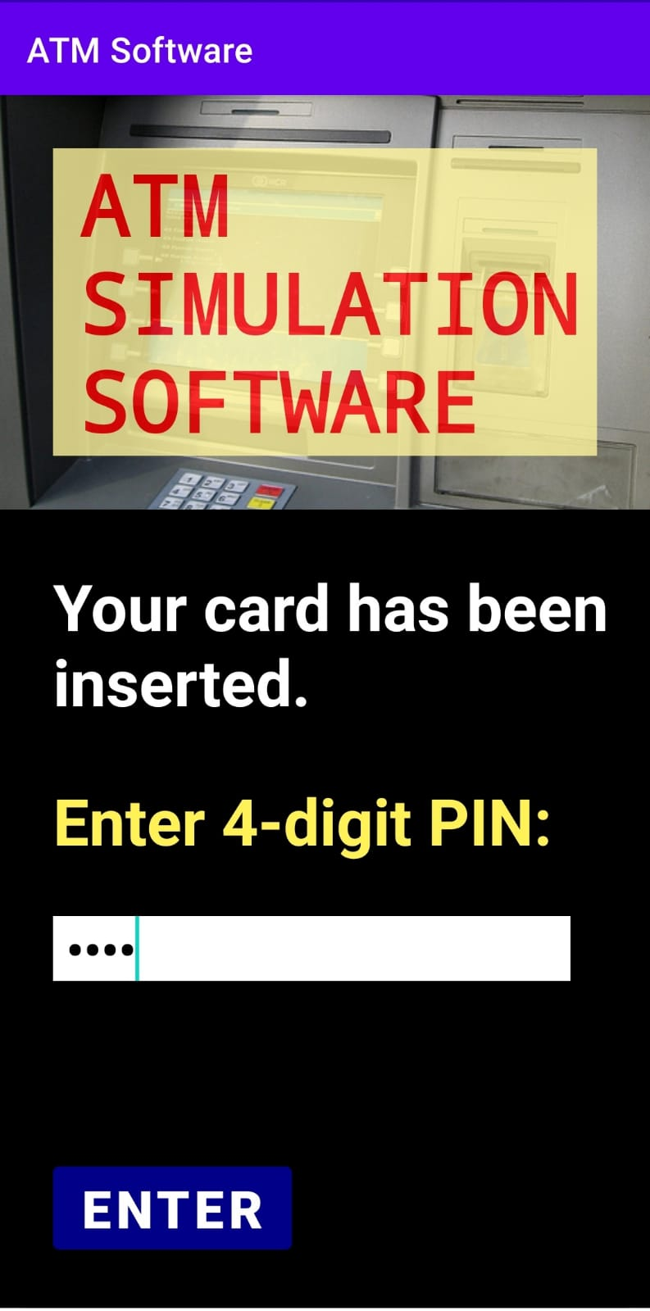
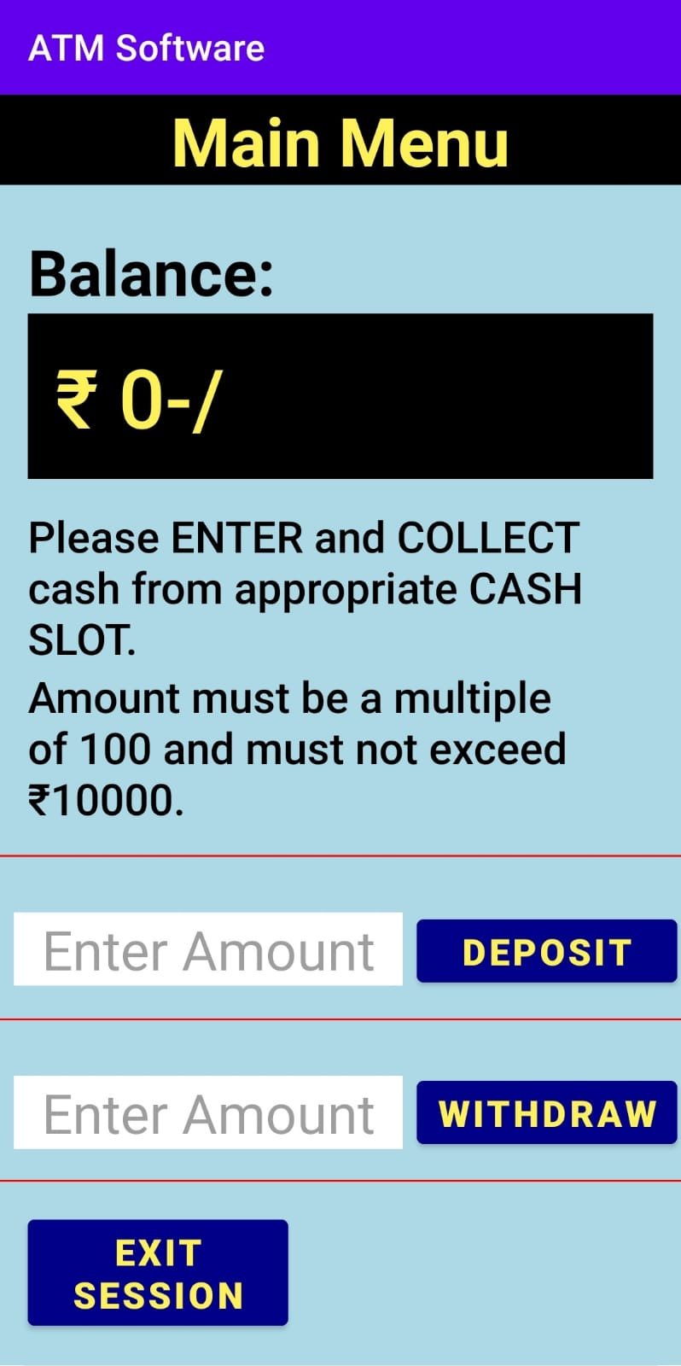
App Details
Name :- ATM SOFTWARE
Size :- 6 MB+
Type :- Multiscreen
System Requirements
Android Version :- Lollipop 5.0+
API :- 21+

Slide 6
STRUCTURE OF ATM SIMULATION SYSTEM APP
ATM SYSTEM
LOGIN SCREEN
MAIN MENU
(Balance, Deposit and Withdrawal)
EXIT SESSION

Slide 7
THANK YOU……

